Slide 1
IPv4 Unicast Extensions
“Legacy IPv4 will coexist with IPv6 indefinitely.”
- The Hidden Standards War: Economic Factors Affecting IPv6 Deployment
John Gilmore, Dave Täht
Paul Wouters
Linux Plumbers, Sept 10th, 2019

Slide 2
IPv4 Unicast Extensions
“Even if they have deployed IPv6, growing networks must continue to acquire scarce, increasingly expensive IPv4 addresses to interconnect with the rest of the Internet.”
- The Hidden Standards War: Economic Factors Affecting IPv6 Deployment

Slide 3
Unicast Addressing Won
Globally routed Unicast is the success story of the Internet
Large % of the traffic is globally routed unicast (some translated from behind NAT)
Global Unicast addresses are the ones we’re running out of
All other kinds of IPv4 addresses are tiny niches
Current IPv4 address allocation doesn’t reflect that.

Slide 4
IPv4 Addresses now COST
An IPv4 address market exists
Current costs are ~US$20 per addr, and rising
Why do we care?
  Innovators need addresses
  Big incumbents are buying them wholesale
    So they won’t ever run out
    And so startups won’t be able to afford to compete
  A barrier to competition from startups
It’s all fine if we want Internet innovation to stop
Or be run by monopolists...

Slide 5
Reducing the Cost
Land speculators say “Buy land, they ain’t making more of it” -
  But we CAN make more IPv4 addresses
  It’s not hard.
  It’s just a few patches...
  A spec change...
  And 5-7 years to deploy

Slide 6
Who Are We?
Tech geeks who do protocols & policy sometimes
We noticed IPv4 addresses are getting expensive and scarce
Investigating what it would take to make more
This is a moonshot talk.
This is not a Linux issue. Or a *BSD issue. Or a Windows issue. It’s a protocol issue with both technical and political aspects.

Slide 7
Who Are We?
John Gilmore
  BOOTP/DHCP, DNSSEC, IPSEC, Cygnus Support
  Co-founder of the Electronic Frontier Foundation (EFF)
Dave Täht
  IETF AQM and BABEL WGs, co-author, FQ_CoDel (RFC8290)
  Director of the Make-Wifi-Fast, CeroWrt, and sch_cake projects
Paul Wouters
  IPSEC, DNS/DNSSEC/, LibreSwan, Red Hat.
  We believe in RUNNING CODE... and rough consensus.

Slide 8
The Internet Isn’t Finished
It’s an experiment. It’s a success disaster. The net arose from the contributions of many people. There were no singular geniuses who gave birth to the internet; rather the internet is a collage of many minds.
There was no grand plan. The internet could have evolved into something quite different than what it is today. Or it could have not evolved at all.
There were (and are) no internet deities.
The internet could have gone other ways (or not at all.)
The internet is more than the World Wide Web.
Government initiatives can produce great things.
“The internet is not finished. There is much yet to be created” - Karl Auerbach

Slide 9
Some IPv4 Address history
Class A, B, C addrs. Now known as /8, /16, /24.
0/8 was “find my network number” in 1984, but didn’t work on LANs. Oops. Retired in 1989, RFC 1122. Replaced by BOOTP, DHCP
127/8 - Loopback got its own Class A network number
224/4 and 240/4 reserved in 1984 for future experiments. No experiment ever took place in 240.
Class A/B/C didn’t fit real networks. CIDR replaced them. Took years to deploy. Required changing every Internet node.
224/4 used in 1988 for multicast, but it never scaled like unicast

Slide 10
Make New IPv4 Addrs How?
A small specification change
Small patches to kernels, userspaces, configs, routers
A set of testbeds – local, then global
Iterate the above until it all works
Only then tackle politics of how to allocate them
Make “running code” to enable later “rough consensus”
“Consensus first” screwed it up 10 years ago. Running code first.

Slide 11
Reserved for Future Use?
The Future is Now.
240/4 as Global Unicast
  Has worked in Linux, MacOS, Android since ~2008
  Last nit fix for linux landed in December
  Patches now available for *BSD
0/8 as Global Unicast
  Never used except 0.0.0.0.

Slide 12
Underutilized Addresses?
While updating every node, extend these too:
127/8 - Loopback
  Only tiny numbers of /24s seen in use
  The other 16 million addresses are unused
  Let’s make them unicast
224/4 - Multicast
  Currently has 268 million addresses
  128m never ever allocated, never used. Make them unicast!
  Reclaiming more is probably feasible.

Slide 13
Patch: 0.0.0.0/8 for Linux
static inline bool ipv4_is_zeronet(__be32 addr)
{
- return (addr & htonl(0xff000000)) == htonl(0x00000000);
+ return (addr == 0);
}
Arguably the function should be renamed!
16,777,215 new IPv4 addresses!

Slide 14
Extend Every Subnet Too
Zeroth address in subnet: fully usable as ordinary host
  Was reserved in 1980s due to 4.2BSD using it for Broadcast (Oops)
  Which made broadcast storms when talking to standard nodes.
  4.2BSD long gone; let users put nodes there!
Final address in subnet: fully usable in Point-to-Point nets
  In LANs, still reserved for Broadcast
  Fully usable as ordinary host in non-LAN subnets.
This extends each /29 from 6 to 7 usable addrs!
And makes P2P interfaces only consume a /31. (RFC3021)

Slide 15
Next Steps
Keep landing patches, testing, doing interop
Document and fix all the problems
Once we can prove everything is working…
Then deal with IETF, IANA , ICANN, RIRs, etc.

Slide 16
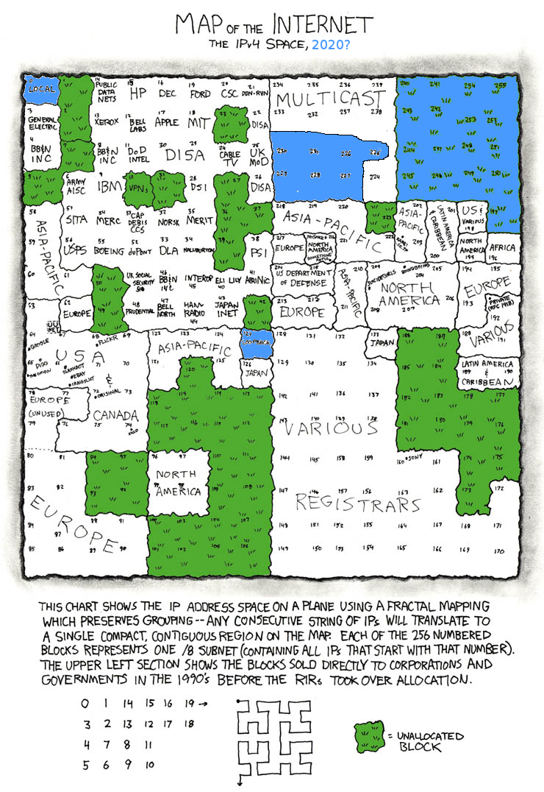
Questions?

Slide 17
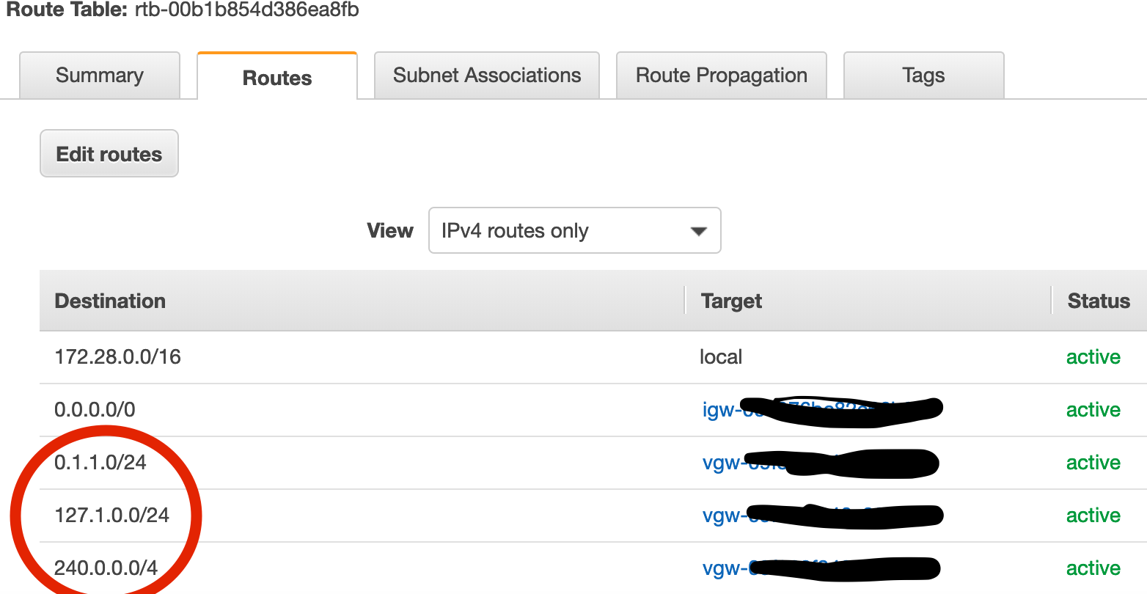
AWS route table

Slide 18
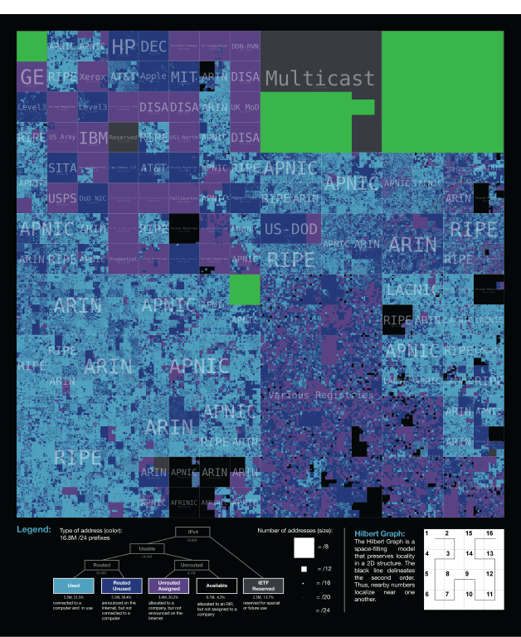
Any Questions?

